Slide 1
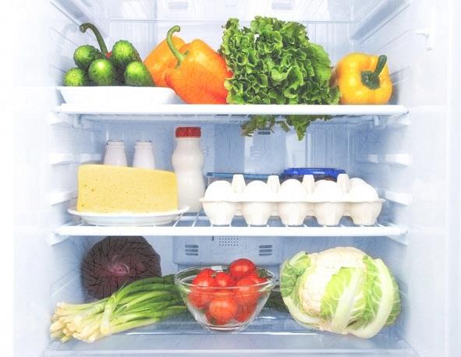
REMOTE MONITORING OF PERESHABLE PRODUCTS USING IOT
BY team SAM
K.SATYA SHIVA SAI RAM
CH.ASHWITHA
T.MANISHA

Slide 2
ABSTRACT:
Food safety is imperative to avoid food borne diseases and to ensure the public health. Monitoring of perishable food products and early detection of degradation will avoid loss due to food wastage and also ensures the freshness of food. In this scenario, remote monitoring of fruits during transportation from field to shelf can ensure the quality of fruit. In this work, a wireless sensor network was designed for monitoring of fruits during transportation and even after storage. Internet of things was also used for facilitating online monitoring of fruits from any remote location. Raspberry pi was used as sensor node and gateway node. It has performed the fusion of sensor data such as temperature, humidity and moisture to avoid redundant data storage and increase the efficiency of decision making.
Our project is not only used in during transportation, it is used in foods cold storage, medical cold storage etc. We can monitor form any place and can be controlled, because it was wireless communication.

Slide 3
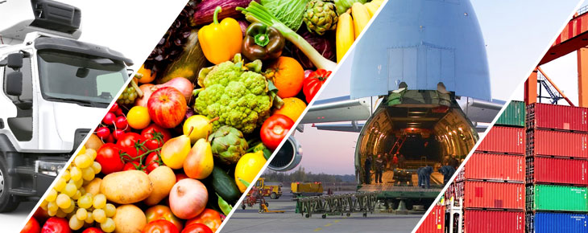
INTRODUCTION
Nowadays, markets and consumers are more demanding of quality services in all areas, including transportation or merchandise. Transporting goods is a complicated endeavor and more so when it comes to products that are sensitive, such as perishable goods.
Keeping fish or fruit from other countries in excellent condition for when they arrive to the consumer’s table is not an easy task. It requires a complex, quality system throughout the entire logistics process, from origin to the final point of distribution.
A perishable good is any product in which quality deteriorates due to environmental conditions through time, such as meat and meat by-products, fish and seafood, dairy products, fruit and vegetables, flowers, pharmaceutical products, and chemicals.

Slide 4
INTRODUCTION cont.
Due to their chemical and/or physiological characteristics, these products have short lifespans; they are more susceptible to severe and irreparable damage during transport, especially if temperature is not kept consistent. These products must be handled with the utmost caution and efficiency in order to preserve them and keep them in excellent condition when they reach the final consumer. In order for this to happen, the key factors to keep in mind are time, isolation, and holding temperature.
Most losses occur between post-harvest and product distribution. These damages affect the final consumer and create major losses for the businesses that sell them.
As previously mentioned, the main issue when transporting perishable goods is to respect the cold chain as much as possible, since it guarantees that the properties of your products are kept intact at all times.

Slide 5
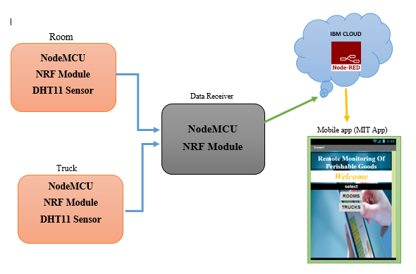
BLOCK DIAGRAM:

Slide 6
HARDWARE & SOFTWARE COMPONENTS
NodeMCU - 2
NRF Modules - 2
DHT11 sensor - 1
Arduino IDE
IBM Cloud
IOT Platform
Node-Red
MIT app inventor-2

Slide 7
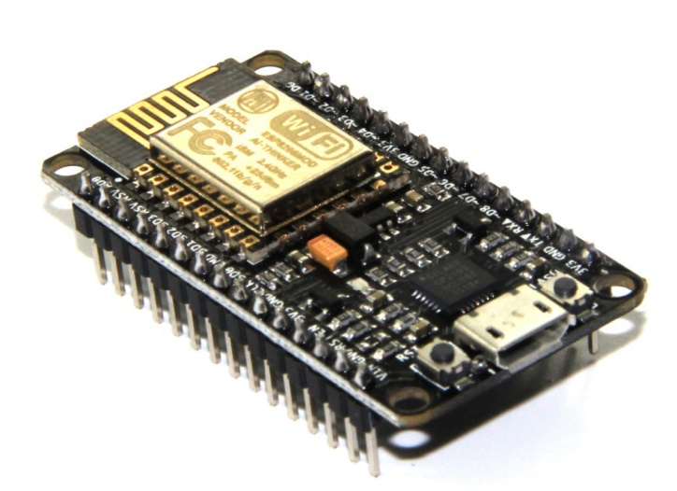
NodeMCU
NodeMCU is an open source IoT platform. It includes firmware which runs on the ESP8266 Wi-Fi SoC from Espressif Systems, and hardware which is based on the ESP-12 module. The term "NodeMCU" by default refers to the firmware rather than the development kits. The firmware uses the Lua scripting language. It is based on the eLua project, and built on the Espressif Non-OS SDK for ESP8266. It uses many open source projects, such as lua-cjson and SPIFFS.
NodeMCU provides access to the GPIO (General Purpose Input/Output) and a pin mapping table is part of the API documentation.

Slide 8
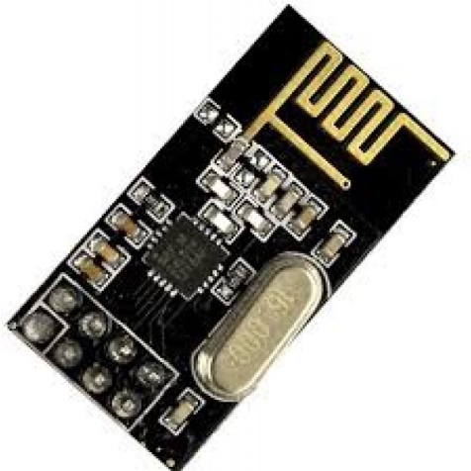
NRF Module
The nRF24L01 is a wireless transceiver module, meaning each module can both send as well as receive data. They operate in the frequency of 2.4GHz, which falls under the ISM band and hence it is legal to use in almost all countries for engineering applications. The modules when operated efficiently can cover a distance of 100 meters (200 feet) which makes it a great choice for all wireless remote controlled projects.
The module operates at 3.3V hence can be easily used with 3.2V systems or 5V systems. Each module has an address range of 125 and each module can communicate with 6 other modules hence it is possible to have multiple wireless units communicating with each other in a particular area. Hence mesh networks or other types of networks are possible using this module.

Slide 9
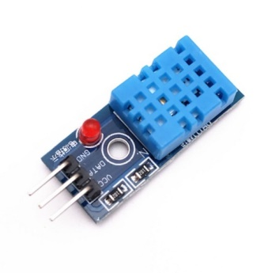
DHT11 sensor
The DHT11 is a basic, ultra low-cost digital temperature and humidity sensor. It uses a capacitive humidity sensor and a thermistor to measure the surrounding air, and spits out a digital signal on the data pin (no analog input pins needed). Its fairly simple to use, but requires careful timing to grab data. The only real downside of this sensor is you can only get new data from it once every 2 seconds, so when using our library, sensor readings can be up to 2 seconds old.

Slide 10
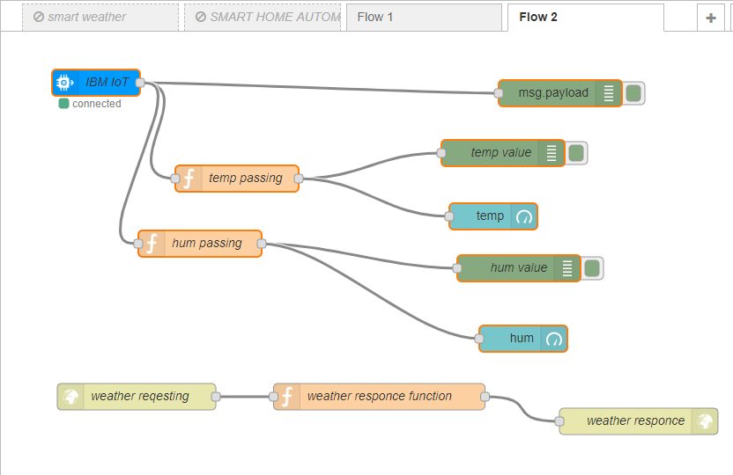
Node-Red FLOW

Slide 11
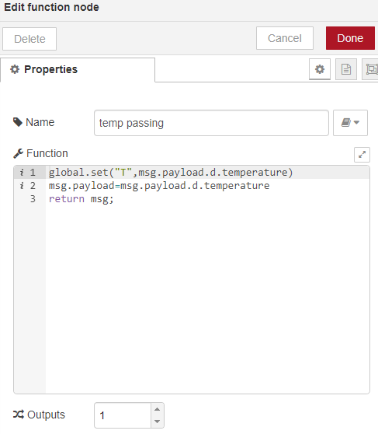
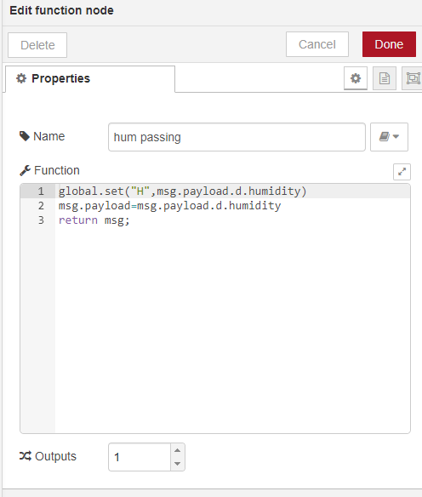
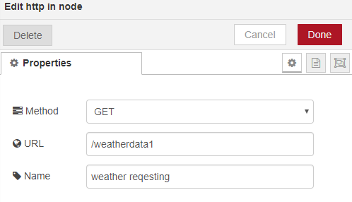
NODE RED properties

Slide 12
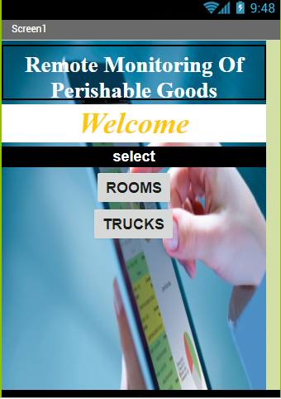
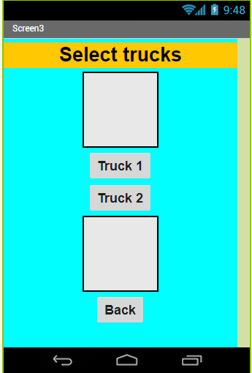
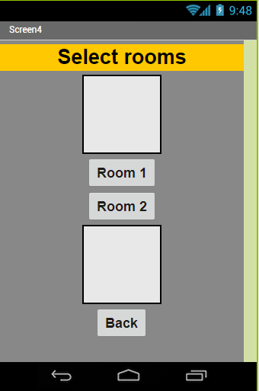
Mit App inventor-2 view

Slide 13
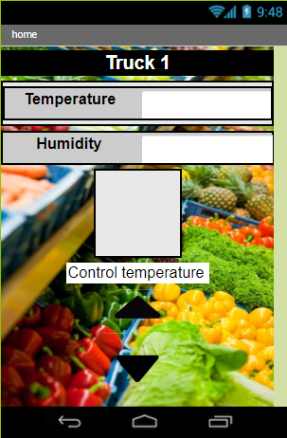
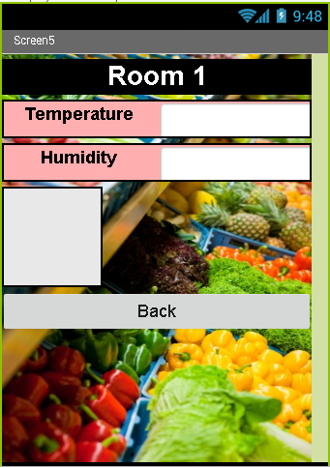
Mit App inventor-2 view

Slide 14
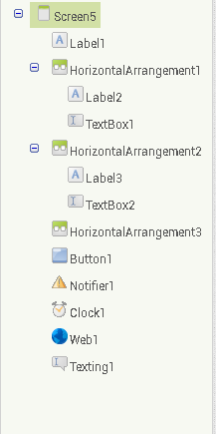
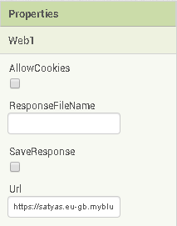
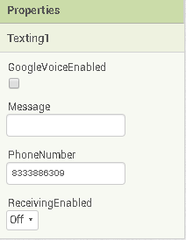
Mit App inventor-2 properties

Slide 15
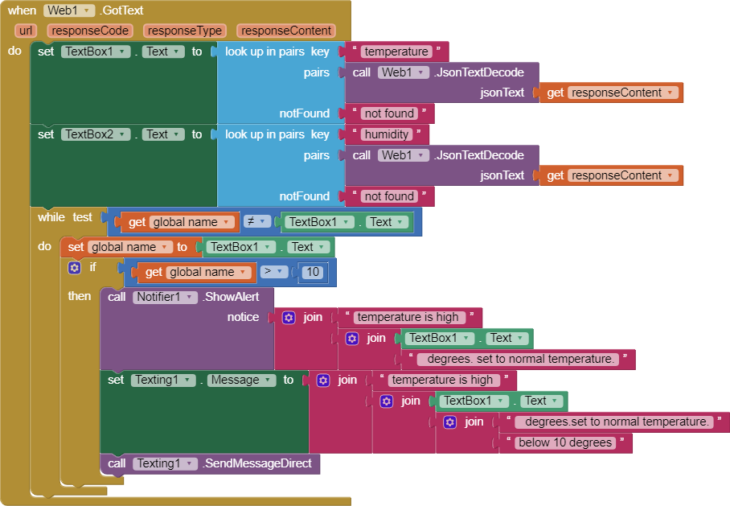


Mit App inventor-2 blocks
Code for Room and Truck

Slide 16
ADVANTAGES:
It avoids the food wastage
Ensure the freshness of food
It gives immediate notifications if temperature is out -of –range
It reduce the labour cost by reducing need for manual temperature tracking and records
It is easy to operate
Disadvantages :
Transmitter and receiver should be in same place (around 90m).
High cost

Slide 17
THANK YOU

